Slide 1
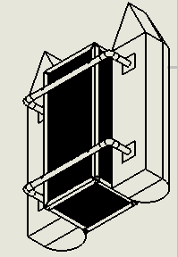
THE DESIGN OF A DEBRIS CLEARING VESSEL
Presented By:
Mohsin Mehmood
& Hafeez Shittu

Slide 2
Outline
Back ground
Project Objective
Design Requirements
Design Constraints
Design Approach
Tasks
Design research
Identifying a design
Mass Calculations
Hydrostatic study
Drag and lift
Electric components layout
Conclusion

Slide 3
Background
Motivation
Plastics and its harmful effects.
Innovating Existing products.

Slide 4
Project Objective
The objective of this project is to design a Catamaran(Dual Hull) marine vessel capable of detecting plastic bottles and collect them using machine learning.

Slide 5
Design Requirements
The main frame of the vehicle should be able to support up to 60 lbs. of total load, including the Payload up to 20 lbs. and 25 lbs. of vehicle itself.
The motors should drive the vehicle with the velocity of 5 miles per hour.
The Design must be cost efficient.
Recognize floating plastic bottles using machine learning.
Should recognize the target (Volume 500ml, height 23.50cm, diameter 6.58, max weight .54kg and function intelligently.

Slide 6
Design Constraints
The main frame of the boat should be within 4ft * 3ft * 2ft (L*W*H)
Budget
Limited Resources.
Easy to assemble.

Slide 7
Tasks
Task 1: Research Various Boat designs
Task 2: Preliminary boat design
Task 3: Weight Calculations
Task 4: Hydrostatic evaluation
Task 5: Fluid dynamics evaluation
Task 6: CAD simulations
Task 7: Building the prototype
Task 1. Project Implementation
Task 2. System design
Task 3. Power Analysis
Task 4. Autonomy Implementation
Task 5. Image Recognition System
Task 6. Image Recognition System Training

Slide 8
Design Approach
Research Various Boat designs
Preliminary Boat designs
Weight Calculations
Hydrostatic study
Fluid Dynamics Calculations
CAD Simulation
Flow Analysis
FEM Analysis
Building a Prototype.
Research Various Boat designs
Preliminary Boat designs
Weight Calculations
Hydrostatic study
Fluid dynamics calculations
CAD Simulation
Flow analysis
FEM analysis
Building a Prototype

Slide 9
Design Approach (Continued)
Project Implementation
System Design
Power Analysis
Autonomous Setup
Images recognition system
System training
Project Implementation
System Design
Power Analysis
Autonomous Setup
Images recognition system
System training

Slide 10
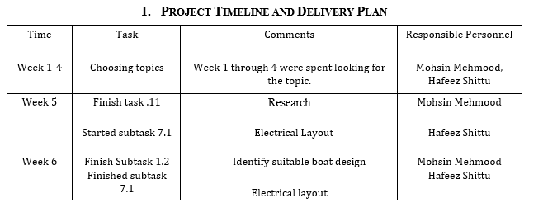
Project Timeline

Slide 11
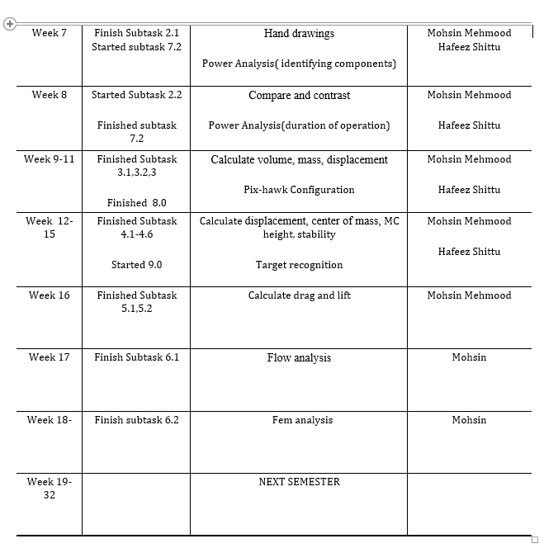
Project Timeline (Continued)

Slide 12
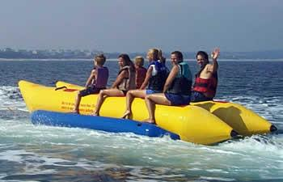
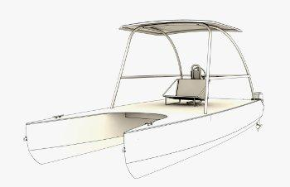
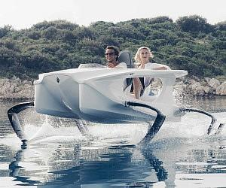
Implementation:
Research
Banana Boats
Hydrofoil boats
Catamaran Boats
Pontoons and its advantages:
Ease of Use/Maintenance
Building Cost and Storage
Longevity

Slide 13
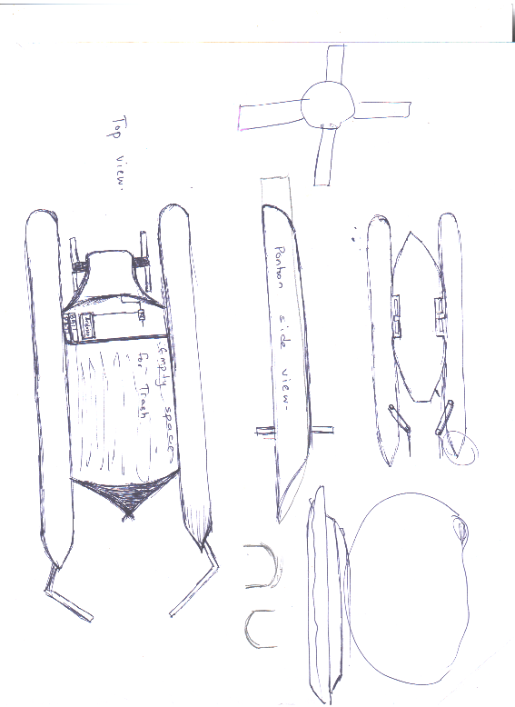
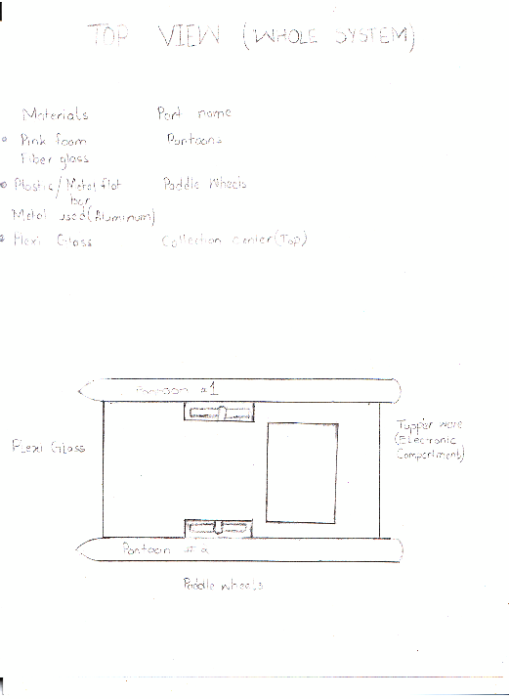
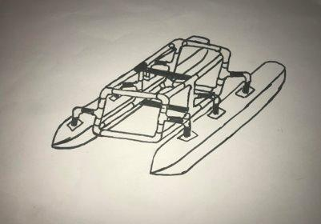
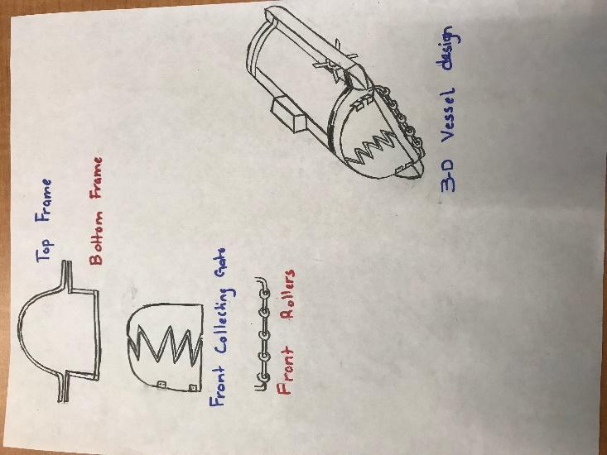
Implementation of Task 2.
Earlier designs:
Pros:
The frame is very light.
The pontoons are also very light.
This is cost-efficient.
The parts can be re-assembled for storage.
Malleable parts.
Cons:
Lack of storage
Shallow ends collection

Slide 14
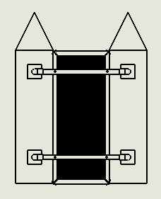
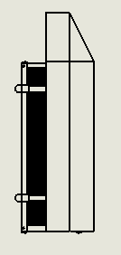
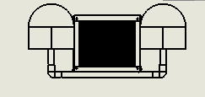
Final design
The 2-D drawings for the final design are as following

Slide 15
Implementation of Task 3 .
Calculate Volume
Calculate mass

Slide 16
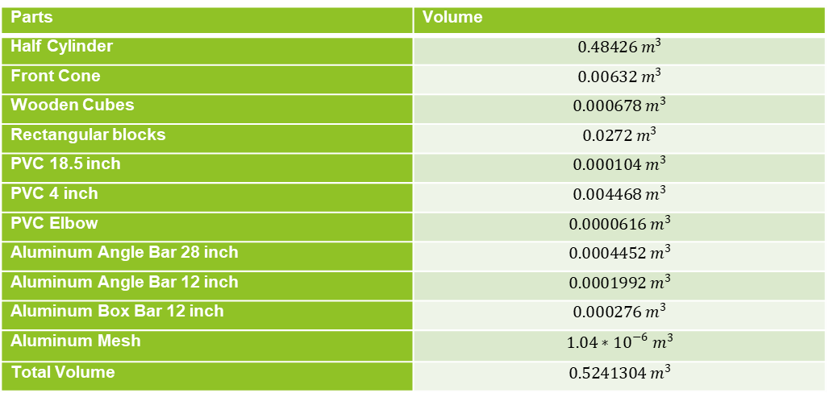
Total Volume table
Parts | Volume
Half Cylinder | $$0.48426 m^{3}$$
Front Cone | $$0.00632 m^{3}$$
Wooden Cubes | $$0.000678 m^{3}$$
Rectangular blocks | $$0.0272 m^{3}$$
PVC 18.5 inch | $$0.000104 m^{3}$$
PVC 4 inch | $$0.004468 m^{3}$$
PVC Elbow | $$0.0000616 m^{3}$$
Aluminum Angle Bar 28 inch | $$0.0004452 m^{3}$$
Aluminum Angle Bar 12 inch | $$0.0001992 m^{3}$$
Aluminum Box Bar 12 inch | $$0.000276 m^{3}$$
Aluminum Mesh | $$1.04∗{10}^{−6} m^{3}$$
Total Volume | $$0.5241304 m^{3}$$

Slide 17
Total Mass table
Parts | Mass
Half Cylinder | 0.48426 kg
Front Cone | 0.13272 kg
Wooden Cubes | 0.92208 kg
Rectangular blocks | 0.5712 kg
PVC 18.5 inch | 0.1352 kg
PVC 4 inch | 0.058 kg
PVC Elbow | 0.08008 kg
Aluminum Angle Bar 28 inch | 0.120204 kg
Aluminum Angle Bar 12 inch | 0.538 kg
Aluminum Box Bar 12 inch | 0.752 kg
Aluminum Mesh | 2.85 kg
Screws | 0.117 kg
Total Mass | 6.760744 kg

Slide 18
Implementation of task 4 >>Mass breakdown
Total weight of the building materials = 6.760744 kg =>14.8736368 pounds
The mass of electronics = 10.17 pounds
Maximum Mass of the payload = 25 pounds
Total weight of the boat including dead weight and payload weight = 50 pounds => 22.72727 kg

Slide 19
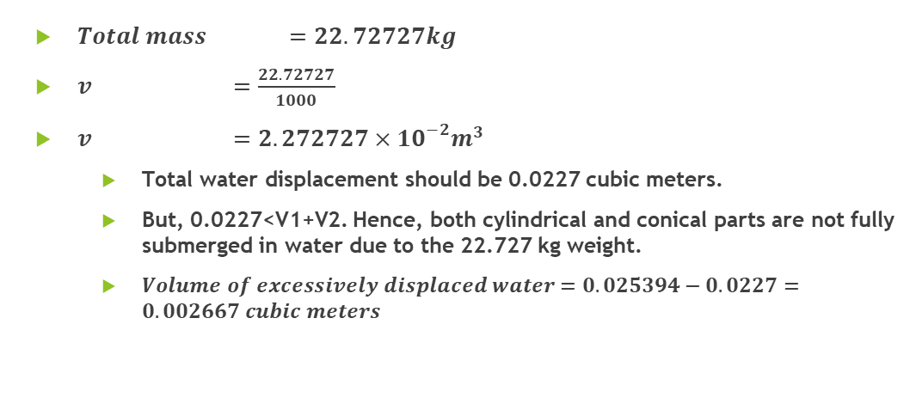
Total Water Displacement
$Total mass =22.72727kg$
$v =\frac{22.72727}{1000}$
$v =2.272727×{10}^{−2}m^{3}$
Total water displacement should be 0.0227 cubic meters.
But, 0.0227<V1+V2. Hence, both cylindrical and conical parts are not fully submerged in water due to the 22.727 kg weight.
$Volume of excessively displaced water=0.025394−0.0227=0.002667 cubic meters$

Slide 20
Height of the boat submerged in water
If height of excessively displaced water is h,

Slide 21
Center of mass (continued)
Since the density of the Styrofoam is extremely low whereas the volume of the PVC parts is negligible, one can assume that the center of mass of the boat is the one of the container.
The distance between the center of mass of semicircle and the center of mass of the respective circle is the following:
.
One can calculate the x and z coordinates of the center of mass of the cone part as follows
Where,
.

Slide 22
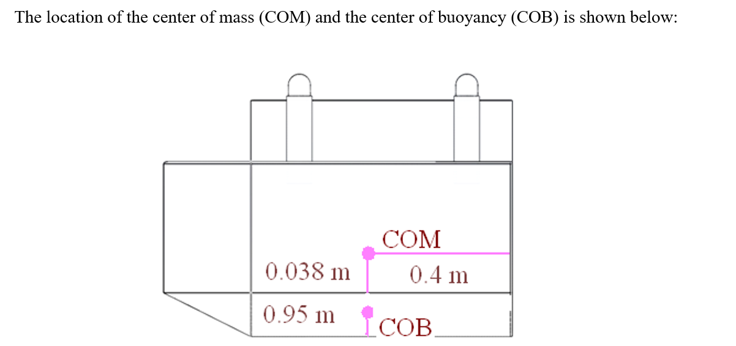
Center of buoyancy
Part | , cubic meters | , meters | , meters | , meters
Left semi-cone | 0.000931 | -0.1396 | 0.4295 | -0.0389
Right semi-cone | 0.000931 | 0.1396 | 0.4295 | -0.0389
Left semi-cylinder | 0.01043 | -0.1396 | 0 | -0.0475
Right semi-cylinder | 0.01043 | 0.1396 | 0 | -0.0475
Center of the buoyancy |  | 0 | 0.035203 | -0.0468

Slide 23
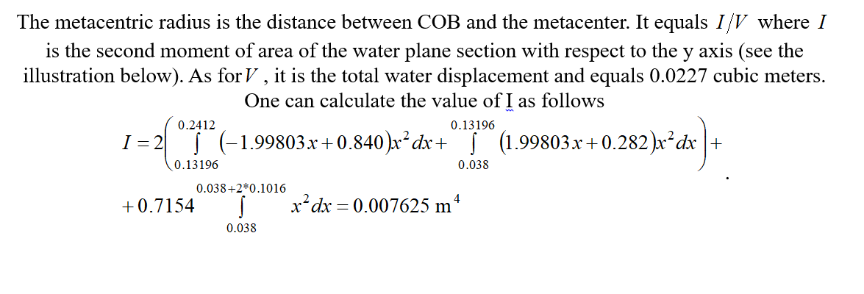
Metacentric radius

Slide 24
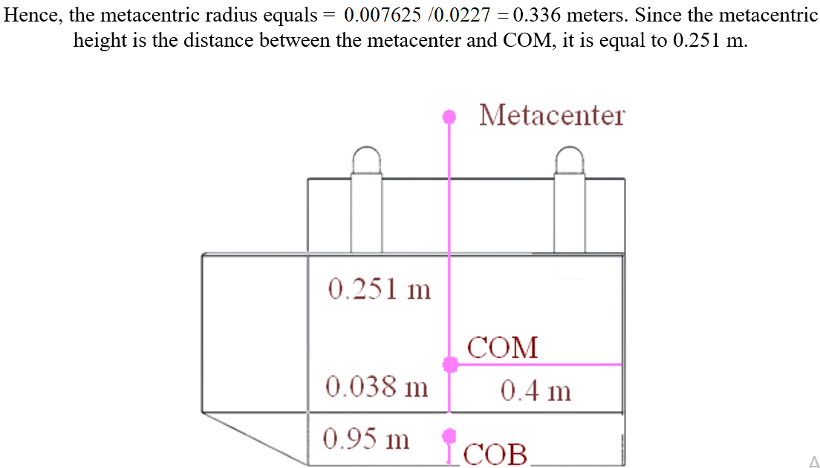
Metacentric height

Slide 25
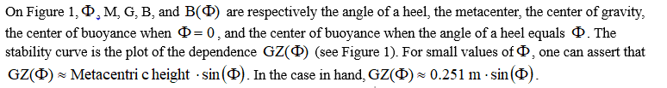
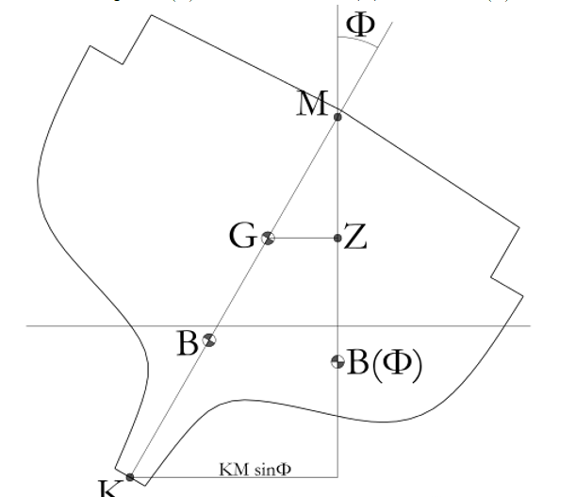
Stability of the boat

Slide 26
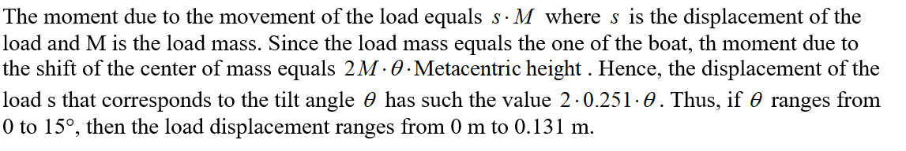
Stability based on 0-15 degrees tilt

Slide 27
Implementation of Task 5
To finding out the Drag and Lift forces that will be applied to the design while moving at the velocity of 5mph.
This will compute the fluid dynamics of the design.
We identified it by using flow simulation.

Slide 28
Implementation of Task 6
Flow simulation
FEA stress analysis.

Slide 29
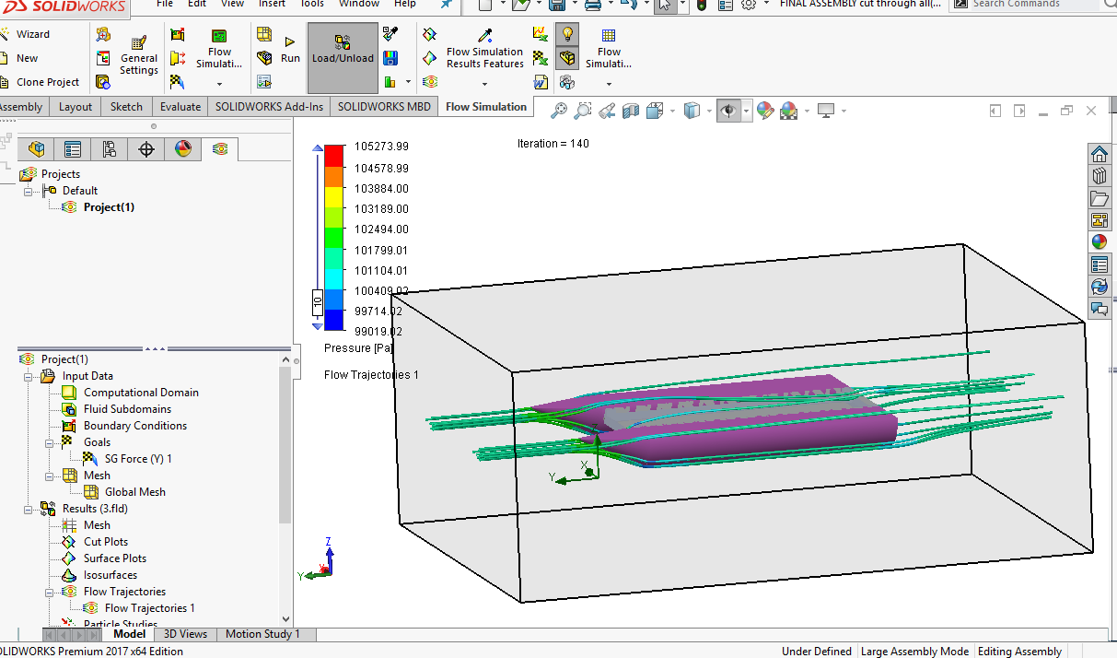
Flow simulation
This Calculated the drag force as 29.37 N

Slide 30
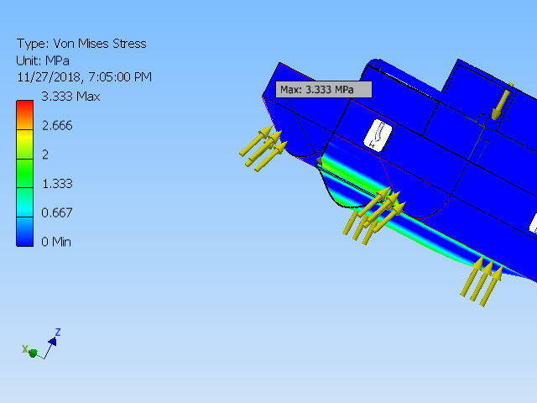
FEA Analysis
Name | Minimum | Maximum
Volume | 63527900 mm^3
Mass | 71.4218 kg
Von Mises Stress | 0.00000066323 MPa | 3.333 MPa
1st Principal Stress | -0.840666 MPa | 2.82522 MPa
3rd Principal Stress | -3.2432 MPa | 1.257 MPa
Displacement | 0 mm | 0.160998 mm
Safety Factor | 15 ul | 15 ul

Slide 31
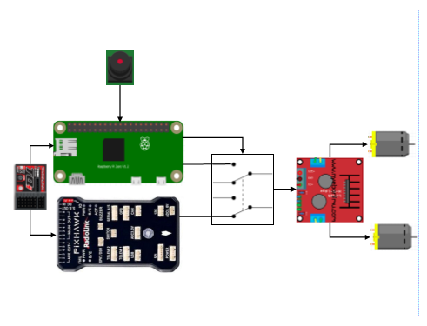
System Design

Slide 32
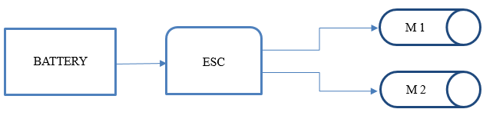
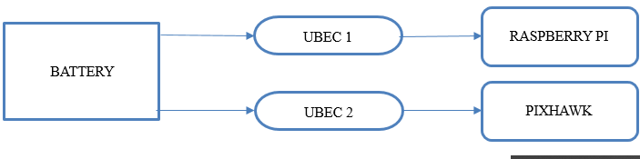
Power Connection Layout

Slide 33
DURATION OF OPERATION
Microcontrollers
ESC and Motors
The battery is connected in parallel to 2 ubec which is then connected to the raspberry pi and pixhawk.
The amp required the ubec is 5.2 A
Battery amp per hour rating = 5000mAh
Operation time: 5/5.2 = 0.96 hr
0.96* 60 = 57.69 mins
The first battery will be used for powering the esc and motors
The 2 esc will be connected to the battery paralleling in order to supply adequate Voltage
Current required for operation by the ESC = 90A
Battery amp per hour rating = 20000mAh
Operation time: 20/90 = 0.222hr
0.222 * 60 = 13.33 mins

Slide 34
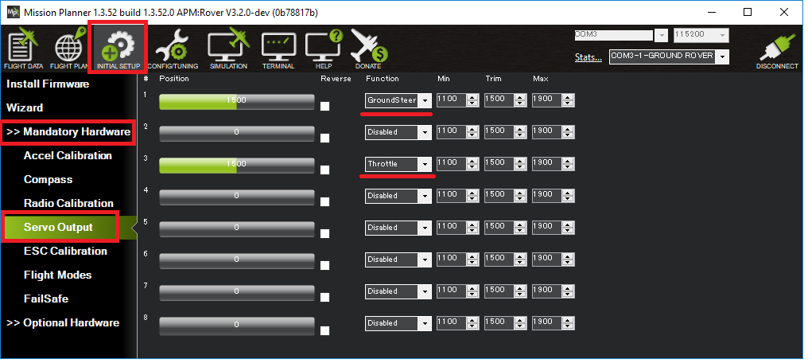
Autonomous Configuration
Boats appear as boats on the ground station (version 3.3.0 and higher)
In Auto, Guided, RTL and SmartRTL modes the vehicle will attempt to maintain its position even after it reaches its destination (version 3.2.0 and higher)
Vectored Thrust can be enabled to improve steering response on boats which use the steering servo to aim the motors (version 3.3.1 and higher)
Loiter mode for holding position
Echosounders for underwater mapping

Slide 35
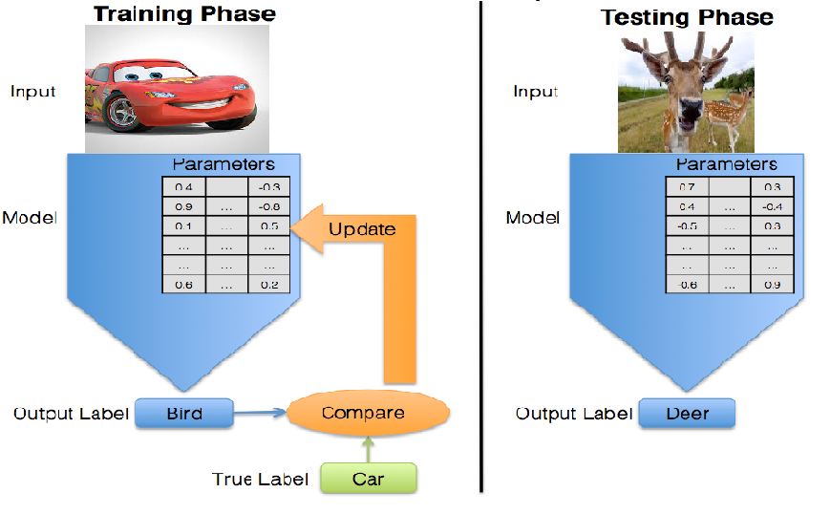
Image recognition Setup

Slide 36
Image recognition Setup
Hardware
Software
Raspberry pi 3
Webcam / pi cam
Micro SD card {containing the Rasbian OS}
A personal computer
Portable Power Supply
Wireless wifi dongle
Mouse
Keyboard
Update the raspberry pi
Install Tensorflow
Install openCV
Compile and install Protobuf
Set up Tensor flow directory Structure and the PYTHONPATH variable
Test the system

